Slide 1
Chapter 6 – Hearn and Baker
2D Viewing

Slide 2
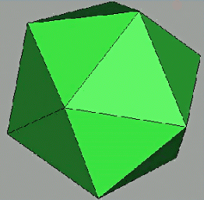
3D Rendering Pipeline
3D Primitives
3D Modeling Coordinates
Model Transformation
3D World Coordinates
Lighting
3D World Coordinates
Viewing Transformation
3D Viewing Coordinates
Projection Transformation
2D Projection Coordinates
Clipping
2D Projection Coordinates
Viewport Transformation
2D Device Coordinates
Scan Conversion
2D Device Coordinates
Image

Slide 3
Contents
3D Rendering Pipeline
2D Rendering Pipeline
Clipping
Viewport Transformation
Scan Conversion
Summary of Transformation

Slide 4
3D Rendering Pipeline
3D Primitives
3D Modeling Coordinates
Model Transformation
3D World Coordinates
Lighting
3D World Coordinates
Viewing Transformation
3D Viewing Coordinates
Projection Transformation
2D Projection Coordinates
Clipping
2D Projection Coordinates
Viewport Transformation
2D Device Coordinates
Scan Conversion
2D Device Coordinates
Image

Slide 5
2D Rendering Pipeline
3D Primitives
2D Primitives
Clipping
Clip portions of geometric primitives
residing outside window
Viewport Transformation
Transform the clipped primitives
from screen to image coordinates
Scan Conversion
Fill pixel representing primitives
in screen coordinates
Image

Slide 6
2D Rendering Pipeline
3D Primitives
2D Primitives
Clipping
Clip portions of geometric primitives
residing outside window
Viewport Transformation
Transform the clipped primitives
from screen to image coordinates
Scan Conversion
Fill pixel representing primitives
in screen coordinates
Image

Slide 7
2D Rendering Pipeline
3D Primitives
2D Primitives
Clipping
Clip portions of geometric primitives
residing outside window
Viewport Transformation
Transform the clipped primitives
from screen to image coordinates
Scan Conversion
Fill pixel representing primitives
in screen coordinates
Image

Slide 8
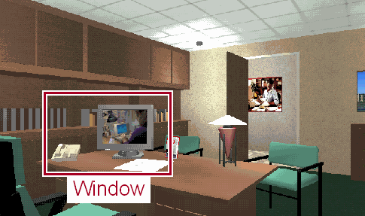
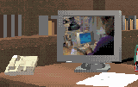
Viewport Transformation
Transform 2D Geometric Primitives from Screen Coordinate System (Projection Coordinates) to Image Coordinate System (Device Coordinates)
Screen
Image
Viewport

Slide 9
Window vs. Viewport
Window
  World-coordinate area selected for display
  What is to be viewed
Viewport
  Area on the display device to which a window is mapped
  Where it is to be displayed

Slide 10
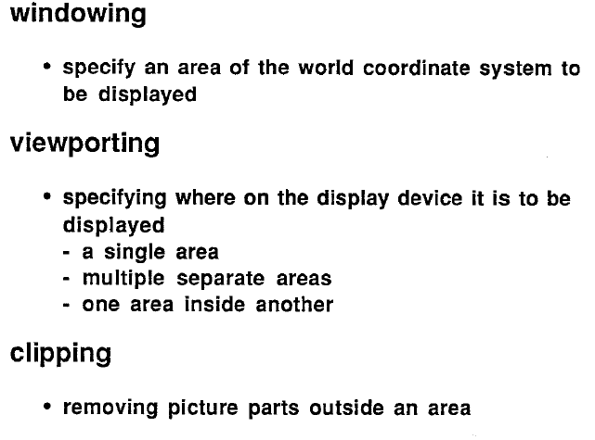
Window Vs Viewport

Slide 11
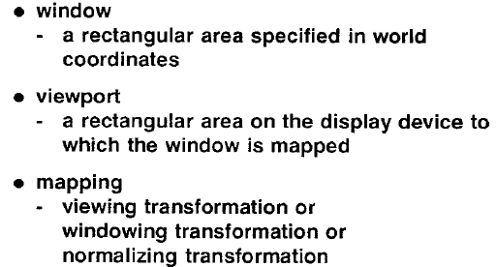
Windowing Concepts

Slide 12
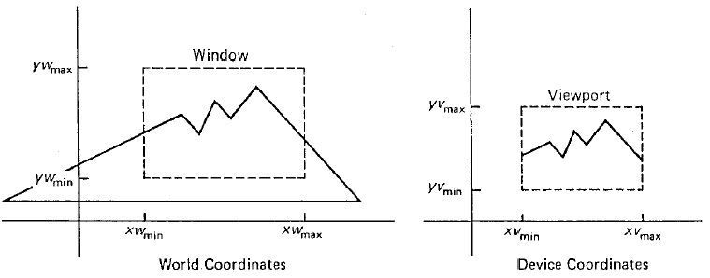
Example

Slide 13
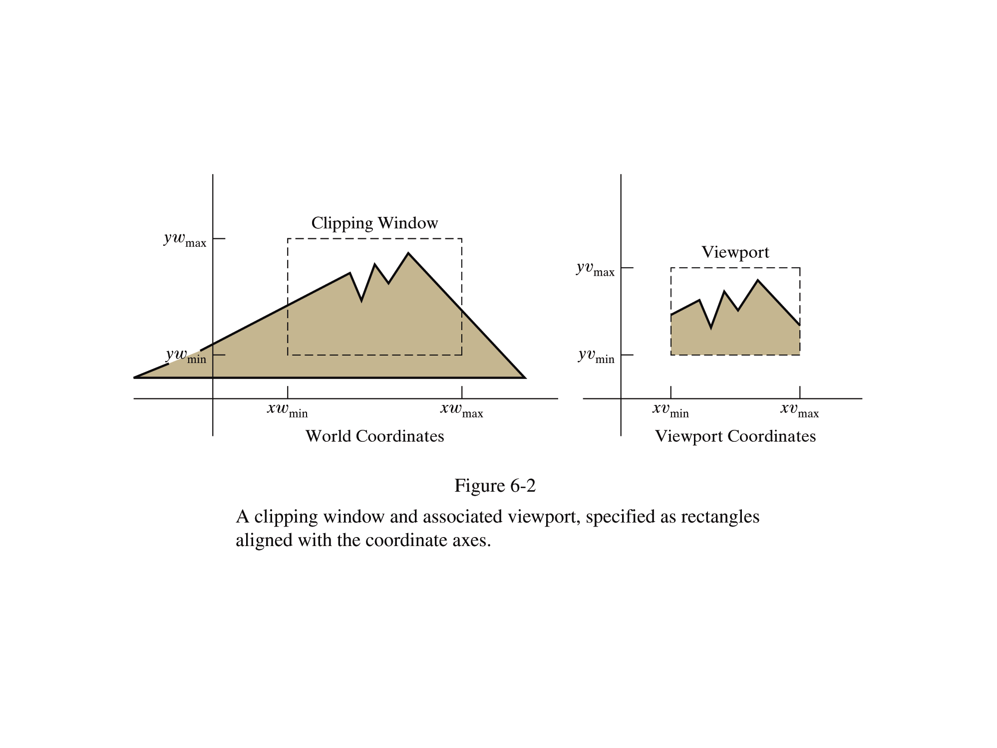

Slide 14
Viewport Transformation
Window-to-Viewport Mapping
Window
Viewport
wy2
vy2
(wx, wy)
(vx, vy)
wy1
vy1
wx1
wx2
vx1
vx2
Screen Coordinates
Image Coordinates
vx = vx1 + (wx – wx1) * (vx2 – vx1) / (wx2 – wx1);
vy = vy1 + (wy – wy1) * (vy2 – vy1) / (wy2 – wy1);

Slide 15
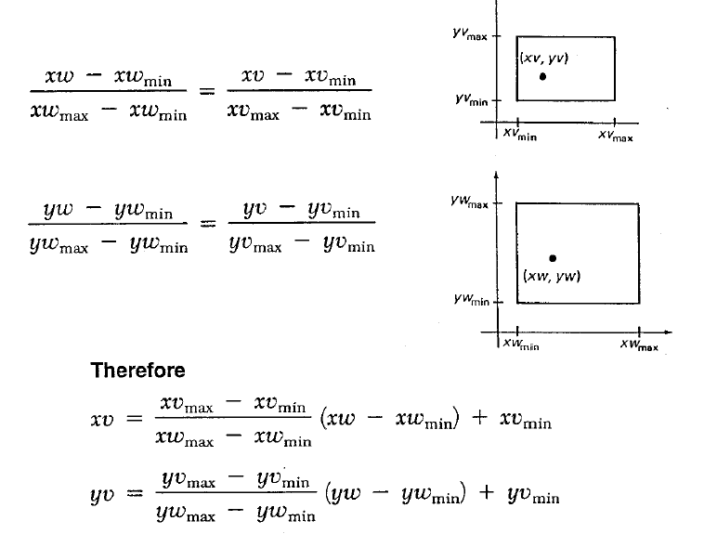
Windows to Viewport Transformation

Slide 16
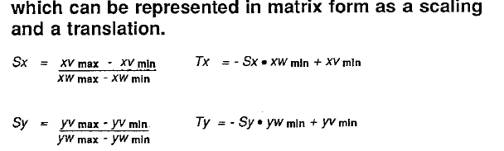
Windows to Viewport
xv = Sx * xw + Tx
yv = Sy * yw + Ty

Slide 17
xv = Sx * xw + Tx
yv = Sy * yw + Ty
Composite Transformation Matrix for transformation to normalized view port
M_{window,} _{normviewp} = [ S_{x} 0 T_{x}
0 S_{y} T_{y}
0 0 1 ]

Slide 18
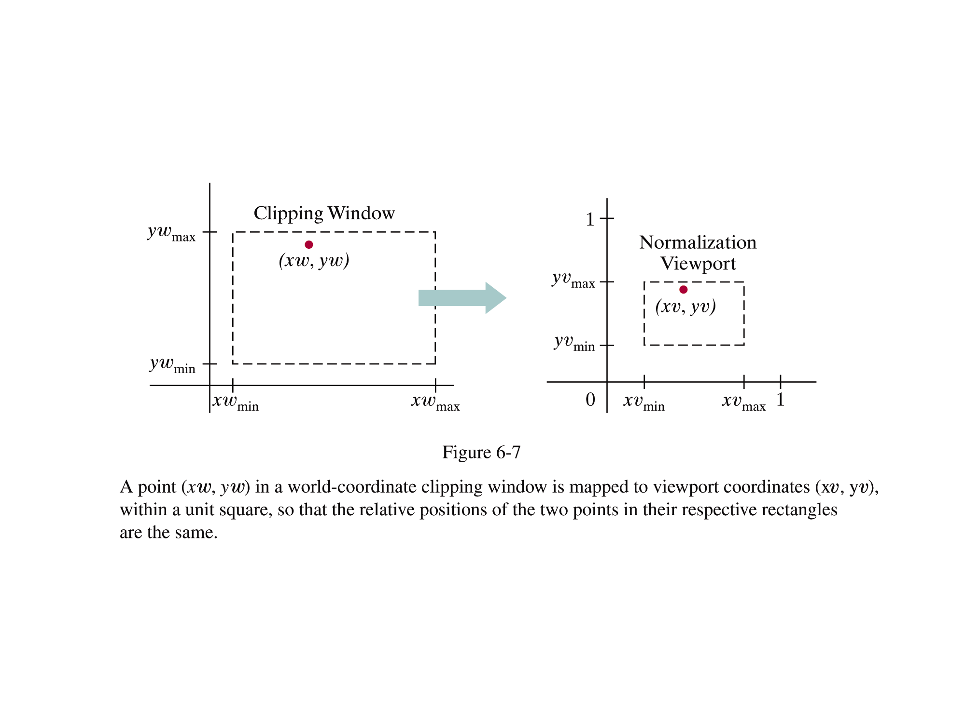

Slide 19
Try this
Convert Window( 0,2.0,0,1.0) =W(l,r,b,t) = W(xw _{min ,} xw _{max} , yw _{min ,} yw _{max} )to V(40, 400, 60, 300) = v( l,r,b,t)
xv= A xw + C
yv= B yw+ D
A= (v.r – v.l) / (w.r-w.l) , C= v.l – A w.l
B= (v.t – v.b) / (w.t-w.b), D= v.b – B w.b

Slide 20
Soln
A = 180, C= 40, B=240, D=60
Sx= 180x + 40;
Sy=240y+60;

Slide 21
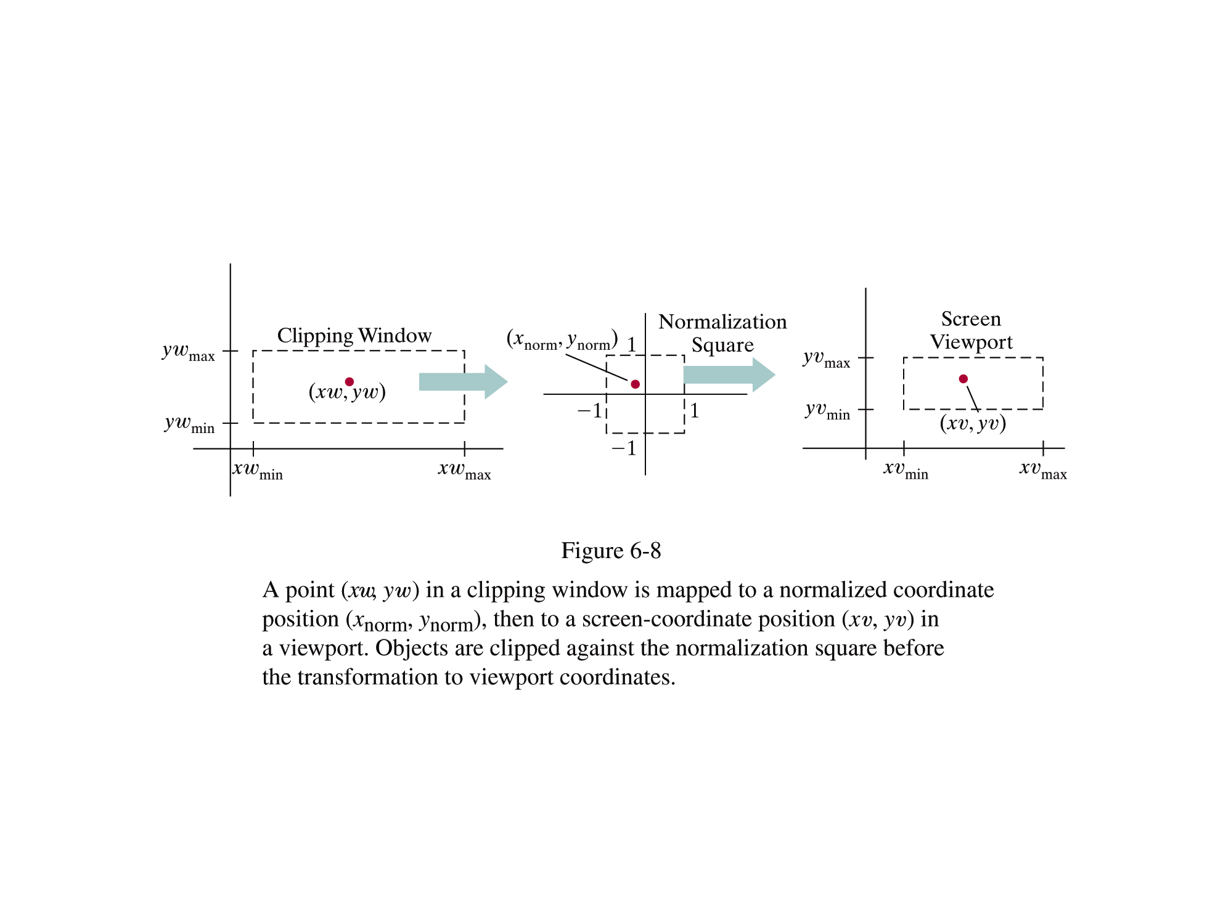

Slide 22
Composite Transformation Matrix for transformation to normalized view port
Mwindow, normviewp = [ Sx 0 Tx
0 Sy Ty
0 0 1 ]

Slide 23
Composite Transformation Matrix for transformation to normalized square by substituting -1 for xvmin and yvmin and +1 for xvmax and yvmax
Mwindow, normsquare = [ Sx 0 Tx
0 Sy Ty
0 0 1 ]

Slide 24
Composite Transformation Matrix for transformation from normalized square to view port by substituting -1 for xwmin and ywmin and +1 for xwmax and ywmax in the following
Mnormsquare, viewport = [ Sx 0 Tx
0 Sy Ty
0 0 1 ]

Slide 25
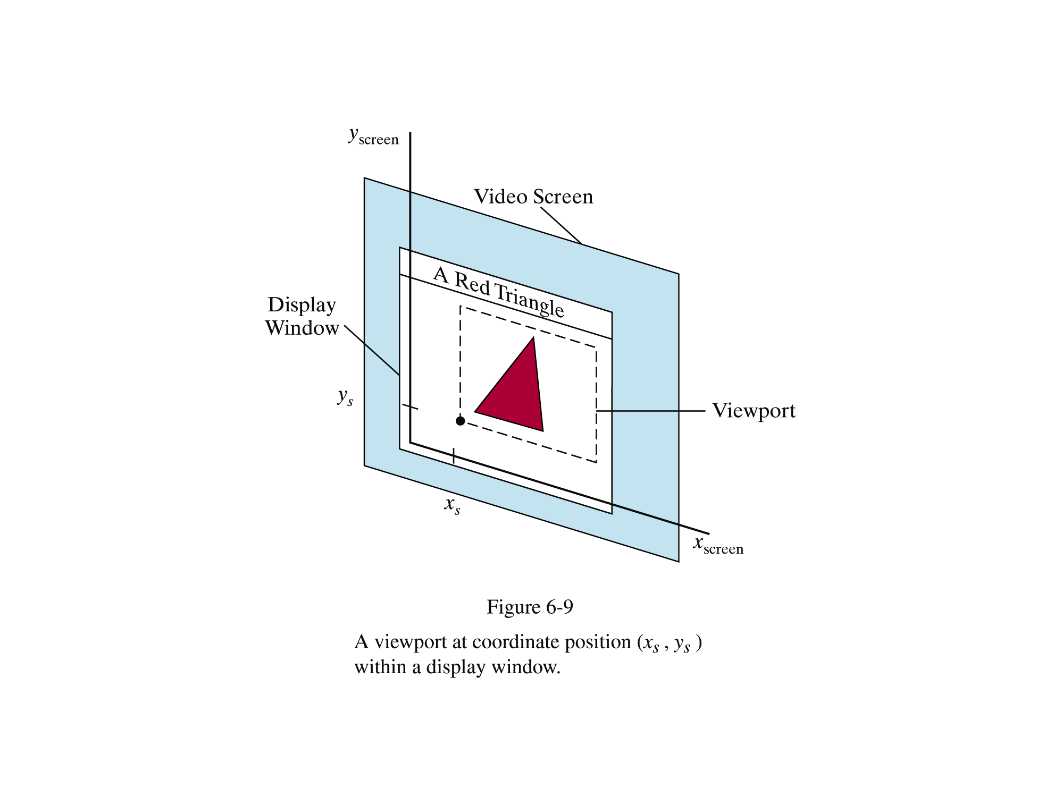

Slide 26
Open GL Implementation
In 2D , world window is set by
gluOrtho2D (0.0, winWidth, 0.0, winHeight); //sets the window to lower left corner (left,bottom)= (0,0) to upper right corner(right,top) = (W,H)
More general case :
void gluOrtho2D (GLdouble left, GLdouble right, GLdouble bottom, GLdouble top);

Slide 27
Open GL Implementation
In 2D , viewport is set by
void glViewport (GLint x, GLinty, GLint width, GLint Height ); //sets the window to lower left corner (x,y)= (0,0) default to upper right corner(right,top) = (x+W, y+H)

Slide 28
OpenGL
In the above problem, we can define
void init(void)
{ glMatrixMode (GL_PROJECTION);
gluOrtho2D (0.0, 2.0, 0.0, 1.0);
glViewport(40, 60,360, 240);
}
If you remove the glViewport, then OpenGL cosiders the default view port set by the window size in main( ) as
glutInitWindowSize( W, H )

Slide 29
User Defined
void setwindow(float left,float right, float bottom, float top )
{
glMatrixMode (GL_PROJECTION);
glLoadIdentity( );
gluOrtho2D (left, right, bottom, top);
}

Slide 30
User Defined
void setViewport (int left,int right, int bottom, int top )
{
glViewport(left, bottom, right-left, top-bottom);
}

Slide 31
2D Rendering Pipeline
3D Primitives
2D Primitives
Clipping
Clip portions of geometric primitives
residing outside window
Viewport Transformation
Transform the clipped primitives
from screen to image coordinates
Scan Conversion
Fill pixel representing primitives
in screen coordinates
Image

Slide 32
Transformation
P(x, y, z)
3D Object Coordinates
Modeling
Transformation
3D World Coordinates
Viewing
Transformation
3D Viewing Coordinates
Projection
Transformation
2D Projection Coordinates
Window-to-Viewport
Transformation
2D Device Coordinates
P(x, y)

Slide 33
Clipping
Avoid Drawing Parts of Primitives Outside Window
  Window defines part of scene being viewed
  Must draw geometric primitives only inside window
World
Coordinates

Slide 34
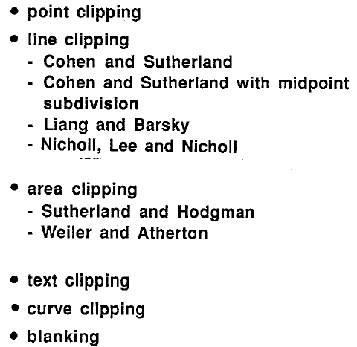
Clipping Algorithms

Slide 35
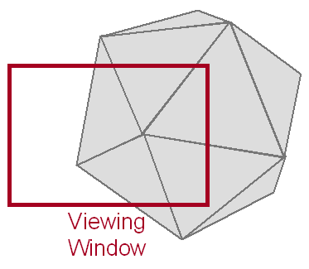
Clipping
Avoid Drawing Parts of Primitives Outside Window
  Window defines part of scene being viewed
  Must draw geometric primitives only inside window

Slide 36
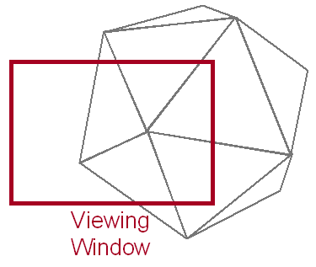
Clipping
Avoid Drawing Parts of Primitives Outside Window
  Points
  Lines
  Polygons
  Circles
  etc.

Slide 37
Point Clipping
Is Point(x,y) Inside the Clip Window?
YWmax
Inside =
(x>=XWmin) &&
(x<=xWmax) &&
(y>=YWmin) &&
(y<=YWmax);
(x, y)
YWmin
XWmin
XWmax

Slide 38

Point Clipping

Slide 39
Line Clipping
Find the Part of a Line Inside the Clip Window
P7
P1
P4
P8
P3
P2
P6
P10
P5
P9
Before Clipping

Slide 40
Line Clipping
Find the Part of a Line Inside the Clip Window
P’7
P4
P’8
P3
P6
P’5
After Clipping

Slide 41
Cohen-Sutherland Line Clipping
Use Simple Tests to Classify Easy Cases First
P7
P1
P4
P8
P3
P2
P6
P10
P5
P9

Slide 42
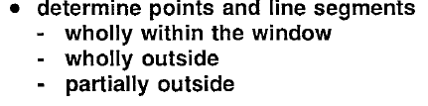
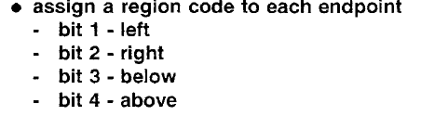
Cohen and Sutherland Line Clipping

Slide 43
Set Bitcode 1,2,3,4 ( 0000)
Can determine the bit code by testing the endpoints with window as follows:
If x is less than Xwmin then set bit 1
If x is greater than Xwmax then set bit 2
If y is less than Ywmin then set bit 3
If y is greater than Ywmax then set bit 4

Slide 44
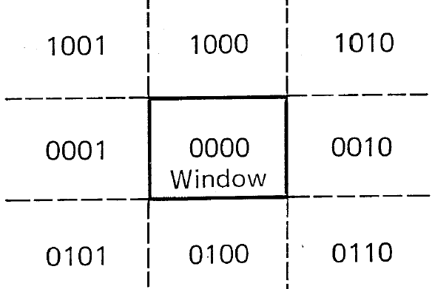
Method – Cohen & S Line Clipping

Slide 45
Cohen-Sutherland Line Clipping
Classify Some Lines Quickly by AND of Bit Codes Representing Regions of Two Endpoints (Must Be 0)
1001
P7
1000
1010
Bit 4
P1
P4
P8
0001
P3
0000
0010
P2
P6
P10
Bit 3
0101
P5
0100
P9
0110
Bit 1
Bit 2

Slide 46
Cohen-Sutherland Line Clipping
Classify Some Lines Quickly by AND of Bit Codes Representing Regions of Two Endpoints (Must Be 0)
P7
Bit 4
P1
P4
P8
P3
P2
P6
P10
Bit 3
P5
P9
Bit 1
Bit 2

Slide 47
Cohen-Sutherland Line Clipping
Classify Some Lines Quickly by AND of Bit Codes Representing Regions of Two Endpoints (Must Be 0)
1001
P7
0001
0101
Bit 4
P4
P8
1000
P3
0000
0100
P6
P10
Bit 3
1010
P5
0010
P9
0110
Bit 1
Bit 2

Slide 48
Cohen-Sutherland Line Clipping
Compute Intersections with Window Boundary for Lines That Can’t be Classified Quickly
1001
P7
1000
1010
Bit 4
P4
P8
0001
P3
0000
0010
P6
P10
Bit 3
0101
P5
0100
P9
0110
Bit 1
Bit 2

Slide 49
Cohen-Sutherland Line Clipping
Compute Intersections with Window Boundary for Lines That Can’t be Classified Quickly
1001
P7
0001
0101
Bit 4
P4
P8
1000
P3
0000
0100
P6
P10
Bit 3
1010
P5
0010
P9
0110
Bit 1
Bit 2

Slide 50
Cohen-Sutherland Line Clipping
Compute Intersections with Window Boundary for Lines That Can’t be Classified Quickly
1001
P7
0001
0101
Bit 4
P4
P8
1000
P3
0000
0100
P6
P10
Bit 3
P’5
1010
0010
P9
0110
Bit 1
Bit 2

Slide 51
Cohen-Sutherland Line Clipping
Compute Intersections with Window Boundary for Lines That Can’t be Classified Quickly
1001
P7
0001
0101
Bit 4
P4
P8
1000
P3
0000
0100
P6
P10
Bit 3
P’5
1010
0010
P9
0110
Bit 1
Bit 2

Slide 52
Cohen-Sutherland Line Clipping
Compute Intersections with Window Boundary for Lines That Can’t be Classified Quickly
1001
P7
0001
0101
Bit 4
P4
P8
1000
P3
0000
0100
P6
P10
Bit 3
P’5
1010
0010
P9
0110
Bit 1
Bit 2

Slide 53
Cohen-Sutherland Line Clipping
Compute Intersections with Window Boundary for Lines That Can’t be Classified Quickly
1001
P7
0001
0101
Bit 4
P4
P8
1000
P3
0000
0100
P6
P10
Bit 3
P’5
1010
0010
P9
0110
Bit 1
Bit 2

Slide 54
Cohen-Sutherland Line Clipping
Compute Intersections with Window Boundary for Lines That Can’t be Classified Quickly
1001
0001
P’7
0101
Bit 4
P4
P8
1000
P3
0000
0100
P6
P10
Bit 3
P’5
1010
0010
P9
0110
Bit 1
Bit 2

Slide 55
Cohen-Sutherland Line Clipping
Compute Intersections with Window Boundary for Lines That Can’t be Classified Quickly
1001
0001
P’7
0101
Bit 4
P4
P8
1000
P3
0000
0100
P6
P10
Bit 3
P’5
1010
0010
P9
0110
Bit 1
Bit 2

Slide 56
Cohen-Sutherland Line Clipping
Compute Intersections with Window Boundary for Lines That Can’t be Classified Quickly
1001
0001
P’7
0101
Bit 4
P4
P’8
1000
P3
0000
0100
P6
P10
Bit 3
P’5
1010
0010
P9
0110
Bit 1
Bit 2

Slide 57
Cohen-Sutherland Line Clipping
Compute Intersections with Window Boundary for Lines That Can’t be Classified Quickly
1001
0001
P’7
0101
Bit 4
P4
P’8
1000
P3
0000
0100
P6
P10
Bit 3
P’5
1010
0010
P9
0110
Bit 1
Bit 2

Slide 58
Cohen-Sutherland Line Clipping
Compute Intersections with Window Boundary for Lines That Can’t be Classified Quickly
1001
0001
P’7
0101
Bit 4
P4
P’8
1000
P3
0000
0100
P6
P10
Bit 3
P’5
1010
0010
P9
0110
Bit 1
Bit 2

Slide 59
Cohen-Sutherland Line Clipping
Compute Intersections with Window Boundary for Lines That Can’t be Classified Quickly
1001
0001
P’7
0101
Bit 4
P4
P’8
1000
P3
0000
0100
P6
P10
Bit 3
P’5
1010
0010
P9
0110
Bit 1
Bit 2

Slide 60
Cohen-Sutherland Line Clipping
Compute Intersections with Window Boundary for Lines That Can’t be Classified Quickly
1001
0001
P’7
0101
Bit 4
P4
P’8
1000
P3
0000
0100
P6
P10
Bit 3
P’5
P’9
1010
0010
0110
Bit 1
Bit 2

Slide 61
Cohen-Sutherland Line Clipping
Compute Intersections with Window Boundary for Lines That Can’t be Classified Quickly
1001
0001
P’7
0101
Bit 4
P4
P’8
1000
P3
0000
0100
P6
P10
Bit 3
P’5
P’9
1010
0010
0110
Bit 1
Bit 2

Slide 62
Cohen-Sutherland Line Clipping
Compute Intersections with Window Boundary for Lines That Can’t be Classified Quickly
1001
0001
P’7
0101
Bit 4
P4
P’8
1000
P3
0000
0100
P6
Bit 3
P’5
1010
0010
0110
Bit 1
Bit 2

Slide 63
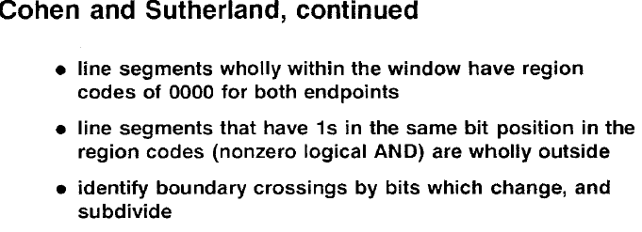

Slide 64
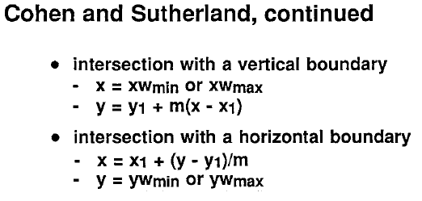

Slide 65
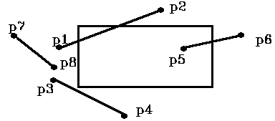
Try this : Perform Cohen S Line Clipping

Slide 66
Set Bitcode 1,2,3,4 ( 0000)
Can determine the bit code by testing the endpoints with window as follows:
If x is less than Xwmin then set bit 1
If x is greater than Xwmax then set bit 2
If y is less than Ywmin then set bit 3
If y is greater than Ywmax then set bit 4

Slide 67
Soln
P1 -> 0001, P2 -> 1000
P3 -> 0001, P4 -> 0100
P5 -> 0000, P6 -> 0010
P7 -> 0001, P8 -> 0001
If both endpoints = 0000 (in window) then display line. If both endpoints have a bit set in same position (P7, P8) then the line is completely outside the window and is rejected.
So: can do logical AND of region codes and reject if result is not 0000

Slide 68
Try this
Let R be a rectangular window whose lower left corner is (-3,1) and upper right corner is (2,6).
Find the region codes for the following end points and draw them w.r.t the window
Given data : A(-4,2) , B(-1,7), C(-1,5), D(3,8)
E(-2,3), F(1,2), G(1,-2), H(3,3)
I(-4,7) and J(-2,10) forming
5 line segments AB ,CD, EF, GH, and IJ

Slide 69
Solution
A(-4,2)→ 0001 ,
B(-1,7)→ 1000
C(-1,5)→ 0000,
D(3,8)→ 1010
E(-2,3)→ 0000,
F(1,2)→ 0000,
G(1,-2)→ 0100,
H(3,3)→ 0010
I(-4,7) → 1001 and J(-2,10)→ 1000

Slide 70
Try this (Contd….)
Find the clipping categories for the 5 line segments given above as :
A) Visible (wholly inside the window)
B) Not visible ( wholly outside )
C) Clipping candidates and do the clipping for them

Slide 71
Soln
Visible : EF since the region codes are both 0000
Not visible – IJ since 1001 AND 1000 = 1000(which is not 0000)
Clipping candidates –
AB - since 0001 AND 1000 = 0000
CD - since 0000 AND 1010 = 0000 &
GH - since 0100 AND 0010 = 0000

Slide 72
Soln for clipping candidates
AB – clip A against vertical boundary – resulting intersection pt - I1(-3, 11/3)
and clip B against the horizontal boundary –I2(-8/5, 6) , Hence I1I2 line seg is displayed.
CD – since D is outside the window, clip it against the horizontal boundary to get
I3(1/3, 6), hence clip I3D and keep CI3
GH- since both G and H are outside the window, start with either of them(say G) to find the intersection point -I4(11/5, 1) = 0010
Hence nothing is displayed.

Slide 73
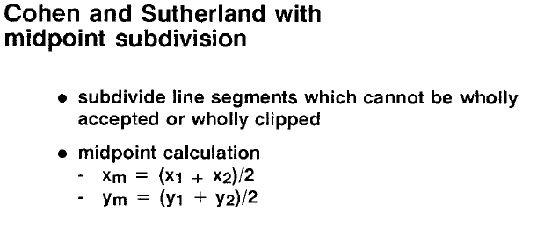

Slide 74
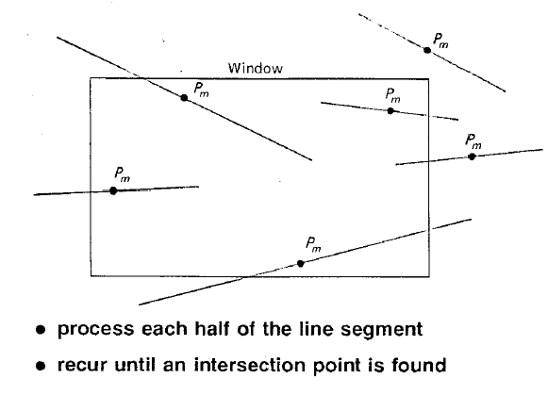
Cohen and Suther –MidPoint

Slide 75
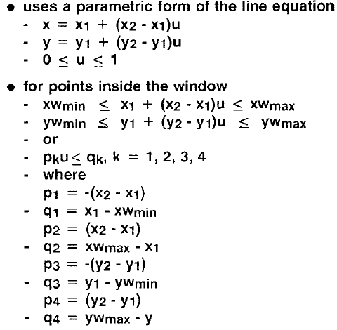
Liang – Barsky Line Clipping

Slide 76
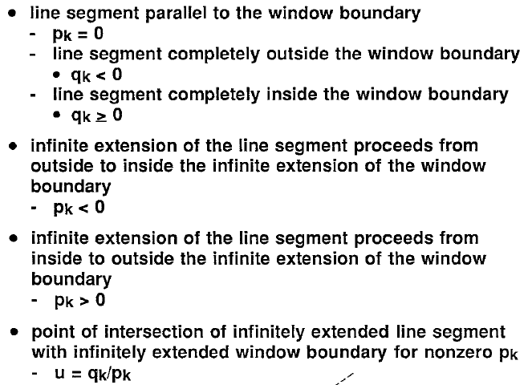
Liang – Barsky Line Clipping

Slide 77
LB Algorithm For Visible portion of Line : 4 steps
If p_{k} = 0 and q_{k} < 0 for any k, eliminate the line and stop. Otherwise proceed to next step.
For all k such that p_{k} < 0, find r_{k} = q_{k} / p_{k.} Let u₁ be the max. of set containing 0 and the calculated r values.
For all k such that p_{k} > 0, find r_{k} = q_{k} / p_{k.} Let u₂ be the min. of set containing 1 and the calculated r values
If u₁ > u₂ , eliminate the line since it is completely outside the clipping window. Otherwise use u₁ and u₂ to find the endpoints of the clipped line.

Slide 78
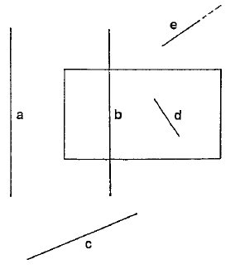
Example

Slide 79
Try this
D
B
H
I
C
G
F
A
E
J

Slide 80
Solution
Given window x –extent : 1 to 9
window y –extent : 2 to 8
A(11,6), B(11,10), C(3,7), D(3,10), E(2,3) , F(8,4), G(6,6) , H(8,9) , I(-1,7) and J(11,1).
For line AB, p₁= 0 and q₁= 10 (left)
p₂= 0 and q₂= -2 (Right)
p₃= -4 and q₃= 4 ( bottom)
p₄= 4 and q₄= 2 (top)
Since p₂ = 0 and q₂ < -2 , AB is completely outside the right boundary.

Slide 81
Sol:
For line CD, p₁= 0 and q₁= 2 (L)
p₂= 0 and q₂= 6 (R)
p₃= -3 and q₃= 5 ; r₃= -5/3 (B)
p₄= 3 and q₄= 1 ; r₄= 1/3 (T)
Thus, u₁ = max(0, -5/3)=0 and
u₂ =min( 1 ,1/3)=1/3 Since u₁< u₂, the two endpoints of clipped line are (3,7) and
(3, 7+ 3(1/3) = (3,8)

Slide 82
Sol:
For line EF, p₁= -6 and q₁= 1, r₁= -1/6 (L)
p₂= 6 and q₂= 7; r₂= 7/6 (R)
p₃= -1 and q₃= 1 ; r₃= -1/1 (B)
p₄= 1 and q₄= 5 ; r₄= 5/1 (T)
Thus, u₁ = max(0, -1/6, -1)=0 and
u₂ =min( 1 ,7/6, 5)=1 Since u₁= 0 and u₂=1,
EF is completely inside the clipping window.

Slide 83
Sol:
For line GH, p₁= -2 and q₁= 5 ; r₁= -5/2 (L)
p₂= 2 and q₂= 3 ; r₂= 3/2 (R)
p₃= -3 and q₃= 4 ; r₃= -4/3 (B)
p₄= 3 and q₄= 2 ; r₄= 2/3 (T)
Thus, u₁ = max(0, -5/2, -4/3)=0 and
u₂ =min( 1 ,3/2,2/3)=2/3 Since u₁< u₂, the two endpoints of clipped line are (6,6) and
(6+ 2 * (2/3), 6+ 3(2/3)) = (22/3,8)

Slide 84
Sol:
For line IJ, p₁= -12 and q₁= -2 ; r₁= 1/6 (L)
p₂= 12 and q₂= 10 ; r₂= 5/6 (R)
p₃= 6 and q₃= 5 ; r₃= 5/6 (B)
p₄= -6 and q₄= 1 ; r₄= -1/6 (T)
Thus, u₁ = max(0, 1/6, -1/6)=1/6 and
u₂ =min( 1 ,5/6,5/6)= 5/6 Since u₁< u₂, the two endpoints of clipped line are ? ? ( 1,6) and (9,2)

Slide 85
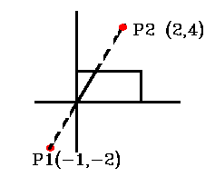
Example

Slide 86
Soln
Let P1 (-1, -2), P2 (2, 4) XWmin = 0, XWmax = 1, YWmin = 0, YWmax = 1
dx = 2 - (-1) = 3 dy = 4 - (-2) = 6
P1 = -dx = -3 ; q1 = x1 - XWmin = -1 - 0 = -1 ; u1=q1 / P1 = 1/3
P2 = dx = 3 ; q2 = XWmax - x1 = 1 - (-1) = 2 ; u2= q2 / P2 = 2/3
P3 = -dy = -6 ; q3 = y1 - YWmin = -2 ; u3=q3 / P3 = 1/3
P4 = dy = 6 ;q4 = YWmax - y1 = 3 ; u4=q4 / P4 = 1/2
for (Pi < 0) t1=MAX (u1,u3,0)=Max( 1 / 3, 1 / 3, 0 )= 1 / 3
for (Pi > 0) t2 = MIN(u2,u4,1)=MIN ( 2 / 3, 1 / 2, 1 ) = 1 / 2

Slide 87
Condition for finding new end points
If tmin < tmax then draw a line from (x1 + dx*tmin, y1 + dy*tmin) to (x1 + dx*tmax, y1 + dy*tmax).
Xnew start, = (x1 + dx*tmin),
Ynew start= (y1 + dy*tmin)
to
Xnew End= (x1 + dx*tmax)
Ynew end= (y1 + dy*tmax)

Slide 88
Soln
Since t1<t2, there is visible section
compute new endpoints
x1’= x1 + dx . t1
= -1 + (3 . 1 / 3) = 0
y1' = y1 + dy . t1
= -2 + (6 . 1 / 3) = 0
X2’ = x1 + dx . t2
= -1 + (3 . 1 / 2) = 1 / 2
y2' = y1 + dy . t2
= -1 + (6 . 1 / 2) = 1

Slide 89
Polygon Clipping (Area Clipping)
Find the Part of a Polygon Inside the Clip Window?
Before Clipping

Slide 90
Polygon Clipping
Find the Part of a Polygon Inside the Clip Window?
After Clipping

Slide 91
Sutherland-Hodgeman Polygon Clipping
Clip to Each Window Boundary One at a Time

Slide 92
Sutherland-Hodgeman Polygon Clipping
Clip to Each Window Boundary One at a Time

Slide 93
Sutherland-Hodgeman Polygon Clipping
Clip to Each Window Boundary One at a Time

Slide 94
Sutherland-Hodgeman Polygon Clipping
Clip to Each Window Boundary One at a Time

Slide 95
Sutherland-Hodgeman Polygon Clipping
Clip to Each Window Boundary One at a Time

Slide 96
Clipping to a Boundary
Do Inside Test for Each Point in Sequence,
Insert New Points When Cross Window Boundary, Remove Points Outside Window Boundary
P2
P1
Window
Boundary
Inside
Outside
P3
P5
P4

Slide 97
Clipping to a Boundary
Do Inside Test for Each Point in Sequence,
Insert New Points When Cross Window Boundary, Remove Points Outside Window Boundary
P2
P1
Window
Boundary
Inside
Outside
P3
P5
P4

Slide 98
Clipping to a Boundary
Do Inside Test for Each Point in Sequence,
Insert New Points When Cross Window Boundary, Remove Points Outside Window Boundary
P2
P1
Window
Boundary
Inside
Outside
P3
P5
P4

Slide 99
Clipping to a Boundary
Do Inside Test for Each Point in Sequence,
Insert New Points When Cross Window Boundary, Remove Points Outside Window Boundary
P2
P1
Window
Boundary
Inside
Outside
P3
P5
P4

Slide 100
Clipping to a Boundary
Do Inside Test for Each Point in Sequence,
Insert New Points When Cross Window Boundary, Remove Points Outside Window Boundary
P2
P1
Window
Boundary
P’
Inside
Outside
P3
P5
P4

Slide 101
Clipping to a Boundary
Do Inside Test for Each Point in Sequence,
Insert New Points When Cross Window Boundary, Remove Points Outside Window Boundary
P2
P1
Window
Boundary
P’
Inside
Outside
P3
P5
P4

Slide 102
Clipping to a Boundary
Do Inside Test for Each Point in Sequence,
Insert New Points When Cross Window Boundary, Remove Points Outside Window Boundary
P2
P1
Window
Boundary
P’
Inside
Outside
P3
P5
P4

Slide 103
Clipping to a Boundary
Do Inside Test for Each Point in Sequence,
Insert New Points When Cross Window Boundary, Remove Points Outside Window Boundary
P2
P1
Window
Boundary
P’
P”
Inside
Outside
P3
P5
P4

Slide 104
Clipping to a Boundary
Do Inside Test for Each Point in Sequence,
Insert New Points When Cross Window Boundary, Remove Points Outside Window Boundary
P2
P1
Window
Boundary
P’
P”
Inside
Outside

